Slide 1
Psychotherapists of new York city
Insights from “Scraping” Psychology Today’s Website “Find a Therapist” for New York City Zip Codes
Dimitri Liakhovitski, PhD

Slide 2
About the Project

Slide 3
New York is a city with a well-established ‘talk therapy’ tradition. But who are those therapists? Information is hard to find.
Google it – you find next
to nothing!
What degrees
do they have?
What patient
types do they
prefer?
Where did
they study?
Who are
they?
What are
their areas of
specialty?
How much
do they
charge?
What
Insurances do
they accept?

Slide 4

Solution? Web scraping! But what web site?
Psychology Today’s “Find a therapist” website is the premium self-advertising platform for psychotherapists.

Slide 5
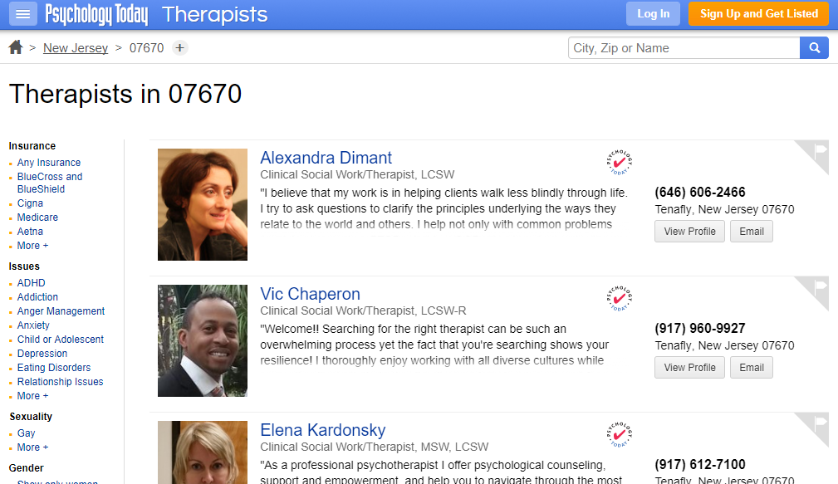
Example: Results of therapist search in one zip code

Slide 6
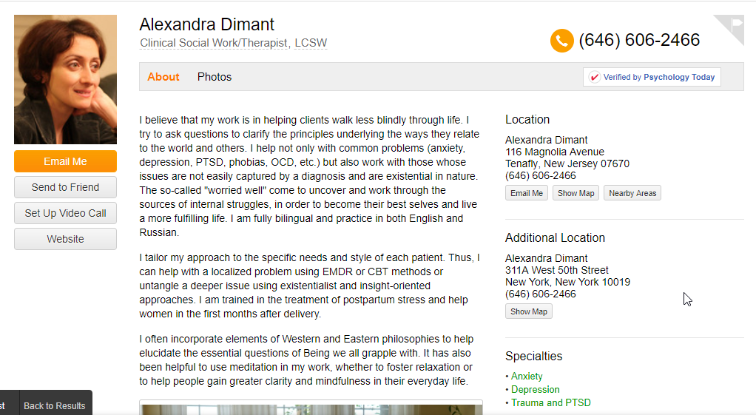
Example: Psychology Today page of one psychotherapist

Slide 7
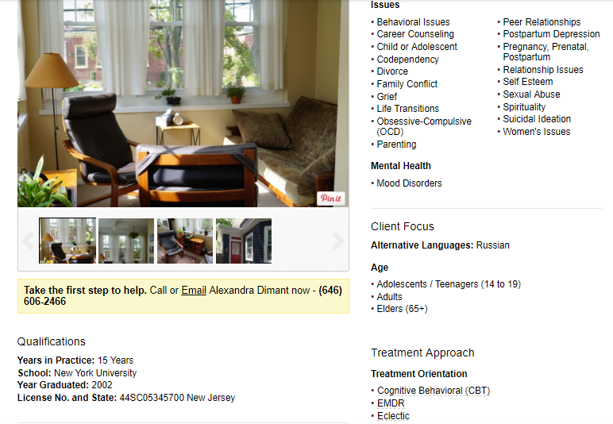
Psychology Today page of one psychotherapist (cont’d 1)

Slide 8
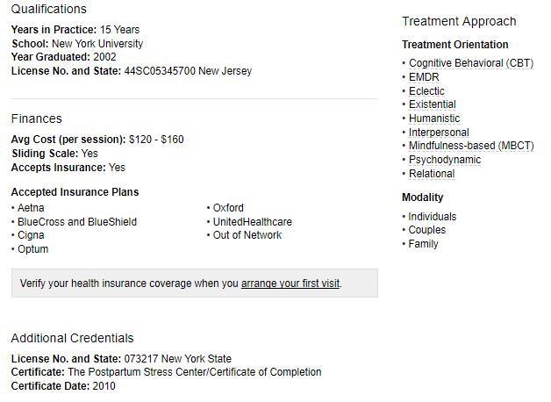
Psychology Today page of one psychotherapist (cont’d 2)

Slide 9
Project Steps
Scraped all therapists in New York city zip codes on October 17-19, 2017.
Analyzed the data & created graphics.
Web Scraping Psychology Today
Data Cleaning
Analysis & Visualization
Cleaned non-standard open-end entries by therapists

Slide 10
NYC Psychotherapists: Who Are They?

Slide 11
What did they study? What are their degrees?
Mostly Clinical Social Workers;
followed by Clinical Psychologists (PhD)

Slide 12
Where did they study?
Mostly schools in or around New York city
NYU is in the lead

Slide 13
When did they finish their studies?
Year of graduation is a “write-in” field
Distribution looks normal
10.5%
5%
32%
17.5%
64%

Slide 14
How long have they been practicing psychotherapy?
Year they started their practice is also a “write-in” field.
Weird spikes around 11,17, 25 and 37 years in practice.

Slide 15
Years since graduation vs. years in practice
They are correlated at 0.84, but:
No explanation for weird spikes around 11,17, 25 and 37 years in practice.

Slide 16
If you are practicing psychotherapy in NY State without a NY license, you are breaking the law, but…
236 therapist (1.9%) listed licenses from states outside NY
Additional 379 therapists (3%) listed no license at all
Are 4.9% of therapists breaking the law?
Most of non-NY state licenses are from NJ, followed by Connecticut

Slide 17
Other languages they speak besides English

Slide 18
NYC Psychotherapists: Fees & Insurance Plans

Slide 19
How much do they charge per session?
Per one session fees listed ranged:
on average, from $135 to $199
Maximum fee listed was $500
Minimum fee listed was $20
80% said they use sliding scale (i.e., willing to charge less in certain circumstances)

Slide 20
How much do they charge per session? Do they accept insurance?
Per one session fees listed ranged:
on average, from $135 to $199.
Maximum fee listed was $500.
Minimum fee listed was $20.
80% said they use sliding scale (i.e., willing to charge less in certain circumstances).
71% of therapists say they accept insurance.
But only 50% list at least one insurance plan they actually accept.
Thus, 21% are not truly accepting insurance, despite their claim they do.

Slide 21
What insurance plans do they accept?

Slide 22
NYC Psychotherapists – Who Do They Focus on?

Slide 23
Age groups they specialize in

Slide 24
Special population groups they are interested in treating

Slide 25
Most popular (among therapists) therapeutic areas of specialty

Slide 26
Less popular (among psychotherapist) specialty areas

Slide 27
Issues therapists specialize in

Slide 28
Issues few therapists specialize in

Slide 29
Therapeutic approaches therapists favor

Slide 30
Less popular therapeutic approaches

Slide 31
NYC Psychotherapists: What Zip Codes Have More Therapists?

Slide 32
Is the world just? Do zip codes with higher population have more therapists?

Slide 33
Is the world just? Do zip codes with higher population have more therapists?
Each dot is one zip code
No justice!
Correlation of just 0.20
Many zip codes with large population but few therapists
Maybe median income per zip code also has an impact?

Slide 34
No wonder: Richer (darker) zip codes have more therapists
Each dot is one zip code

Slide 35
How about median income vs. number of therapists?
Each dot is one zip code
Correlation of 0.48 (!)
If both are logged, correlation is 0.51
Higher income → more therapists
Clearly, both population size AND income impact the number of therapists.

Slide 36
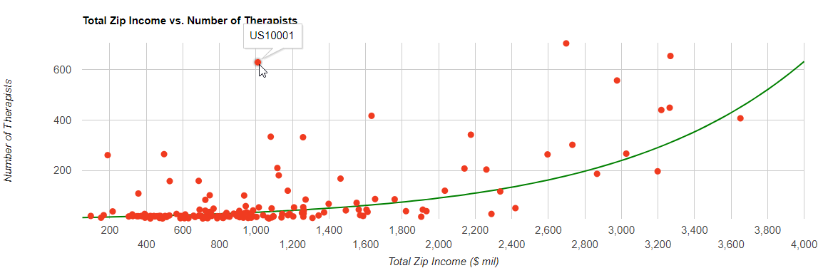
How about TOTAL income vs. number of therapists?
Total income proxy = median income * number of households
Correlation of 0.63 (!)
Each dot is one zip code

Slide 37
How about median income vs. session fee?
Each dot is one zip code
Correlation of 0.44
Higher income is associated with higher fees

Slide 38
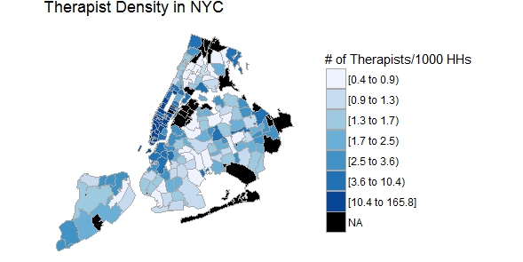
Map of “therapist density” in NYC by zipcode

Slide 39
Zip codes with the highest “density” of therapists
“Density” = number of therapists per 1000 households
All these top zip codes are rich Manhattan zip codes

Slide 40
Zip codes with the lowest “density” of therapists
“Density” = number of therapists per 1000 households
All these top zip codes are the poorest neighborhoods – and they are outside Manhattan.

Slide 41
Directions for future research
How do specialties / approaches / issues cluster?
What therapist characteristics predict session fee and/or acceptance of insurance, and how?
Collect additional data at zip level, e.g., number of people working in each zip code, to further study possible causes of differing therapist density.
Practical Implications of this data set:
Therapist considering opening a practice in a given NYC zip code could gain valuable insights that allow them to differentiate themselves from competitors.

Slide 42
Thank you! Q&A

